Slide 1

Design & Analysis of Algorithms
Saman Riaz (PhD)
Associate Professor
RSCI, Lahore
Lecture # 04

Slide 2
Merge Sort

Slide 3
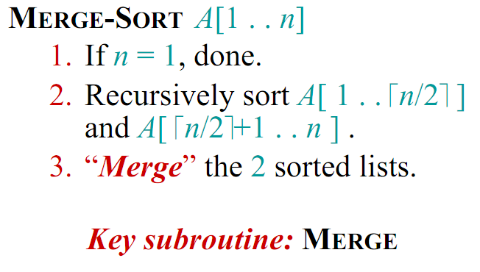
Merge Sort (Divide and Conquer)

Slide 4
Merge Sort Example
20
13
7
2
12
11
9
1
1
2
7
9
11
12
13
20

Slide 5
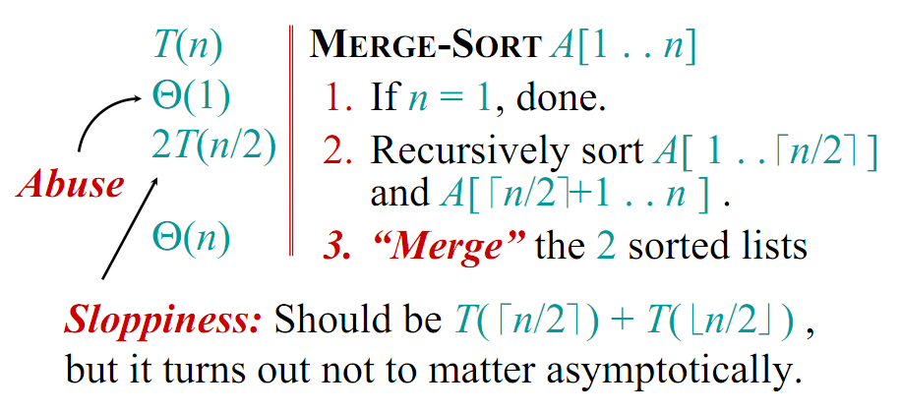
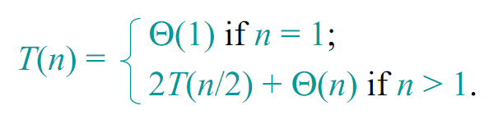
Analysis of Merge Sort

Slide 6
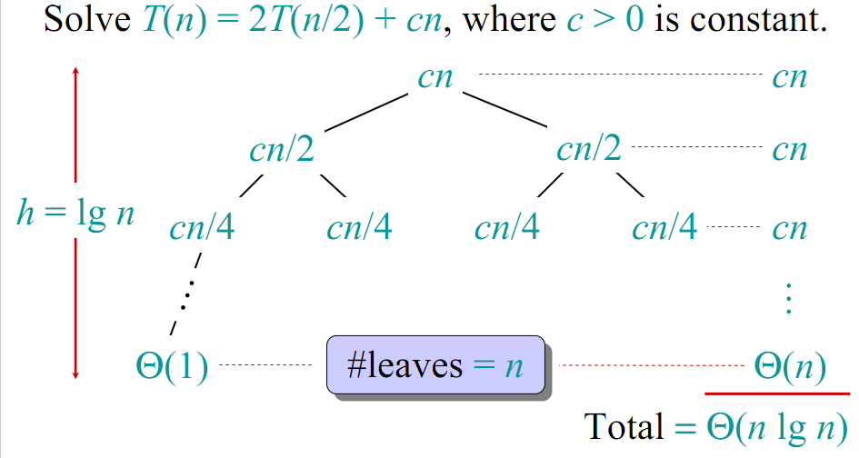
Visual Representation of the Recurrence for Merge Sort

Slide 7
Conclusion
Θ(nlgn) grows more slowly than Θ(n²)
Therefore, merge sort asymptotically beats insertion sort in the worst case.
In practice, merge sort beats insertion sort for n >=3

Slide 8
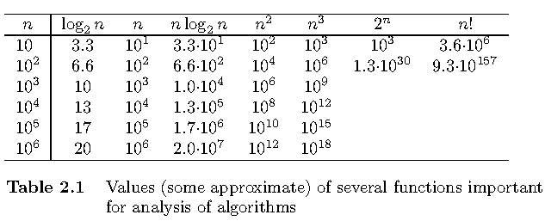
Orders of Growth

Slide 9
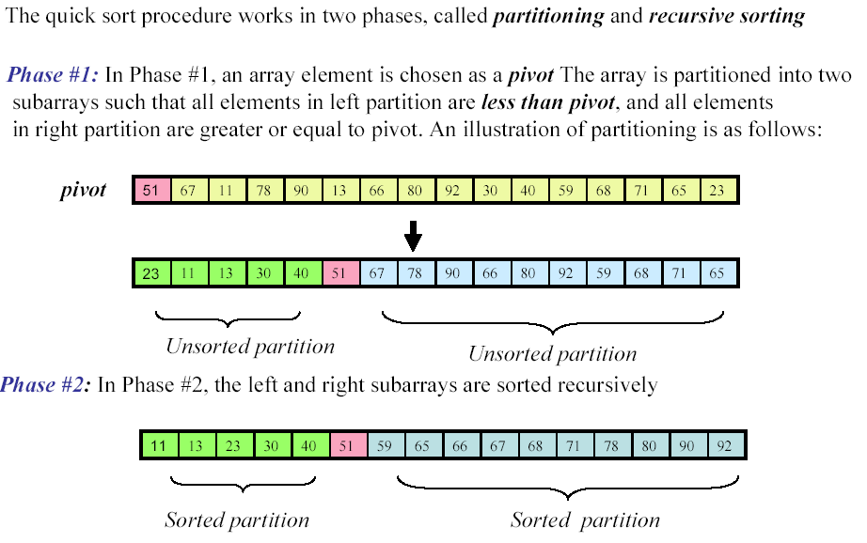
Quick Sort

Slide 10
Pseudo code
QUICKSORT(A, p, r)
if p < r
then q ← PARTITION(A, p, r)
QUICKSORT(A, p, q-1)
QUICKSORT(A, q+1, r)

Slide 11
Pseudo code
PARTITION (A, p, r)
x ← A[r]
i ← p-1
for j ← p to r-1
do if A[j] <= x
then i ← i+1
exchange A[i] ↔ A[j]
exchange A[i+1] ↔ A[r]
return i+1

Slide 12
Analysis of QuickSort
Running time of Quicksort depends on whether partition is balanced or unbalanced
This in turn depends on elements used for partitioning

Slide 13
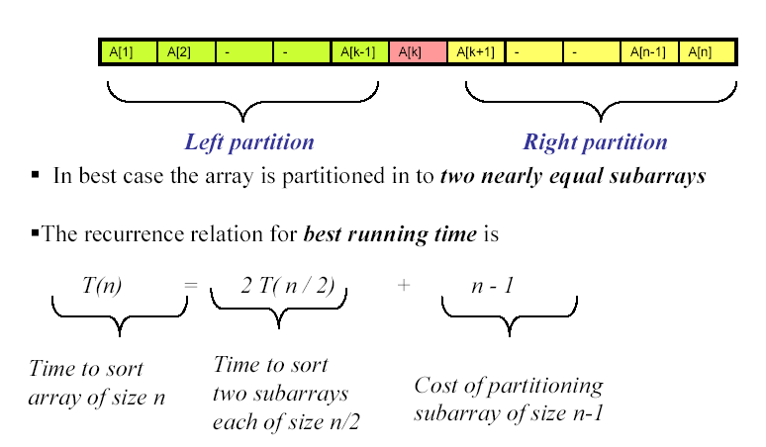
Best-case scenario

Slide 14
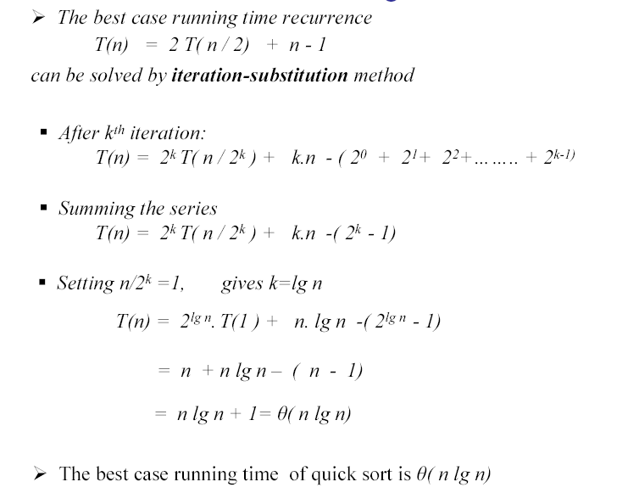
Best-case scenario (contd…)
Notes:
Sum from 0-(n-1)=(1-r^n)/1-r

Slide 15
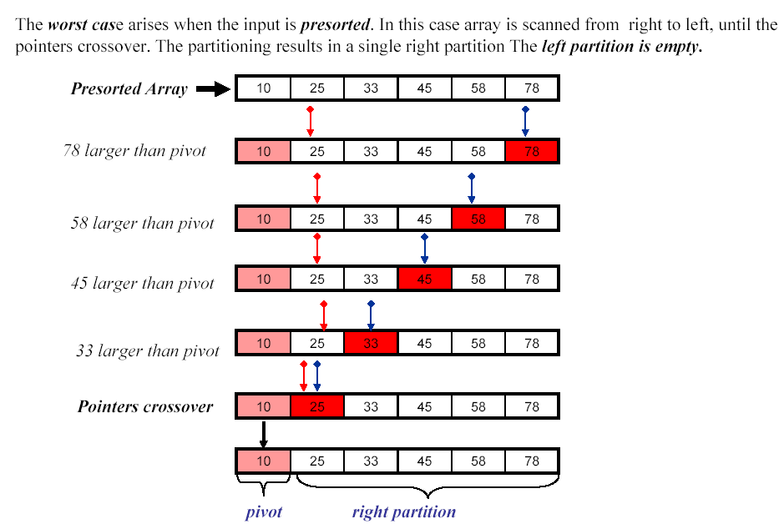
Worst-case scenario

Slide 16
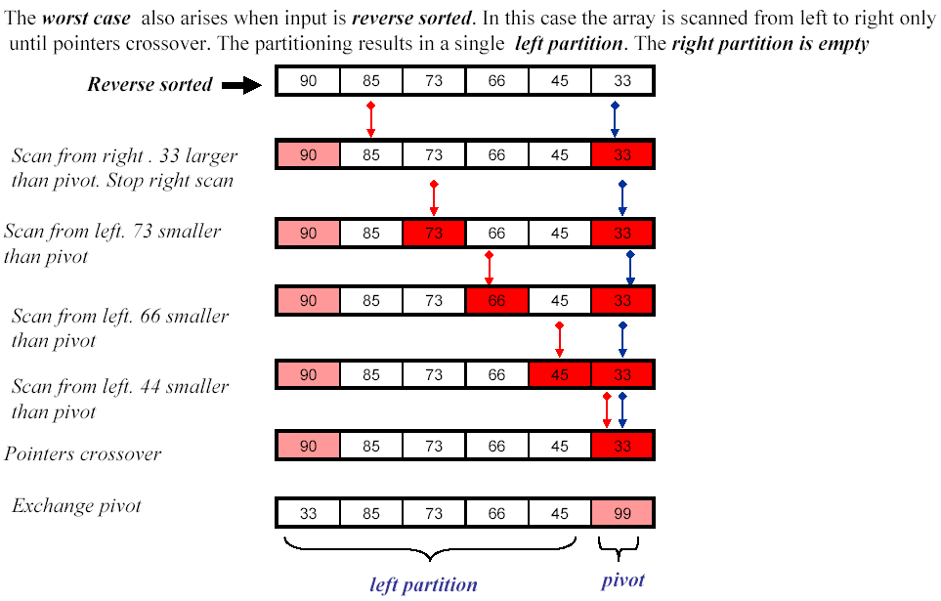
Worst-case scenario (contd…)

Slide 17
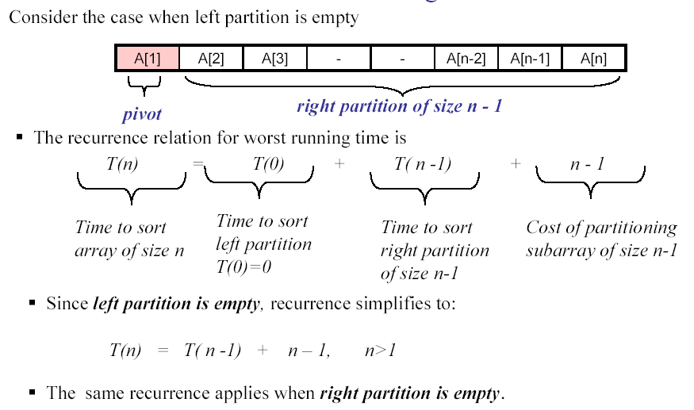
Worst-case scenario (contd…)

Slide 18
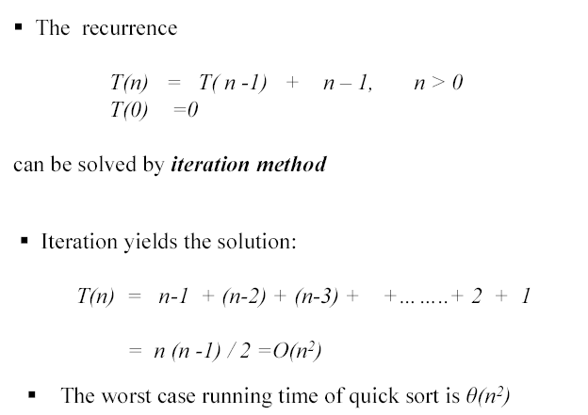
Worst-case scenario (contd…)

Slide 19
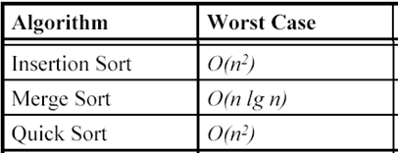
Sorting Algorithms - Running Times
The sorted order determined by these algorithms is based only on a comparison between input elements
These algorithms are thus called comparison sorts

